Slide 1





Techcombank Financial Dashboard
A visualization of Techcombank, one of the leading commercial joint stock bank in Vietnam, and its annual financial indicators from 2011 to 2023.
Created by:
Hoàng Quang Huy

Slide 2





The Outline
Basic indicators
Cash Flow Analysis
TOI, OPEX, CIR, ROE and ROA
OPEX analysis
Trend Analysis
Further Analysis
TOI and CIR
ROE and ROA comparison
NIM and the Correlation between NIM and CIR

Slide 3

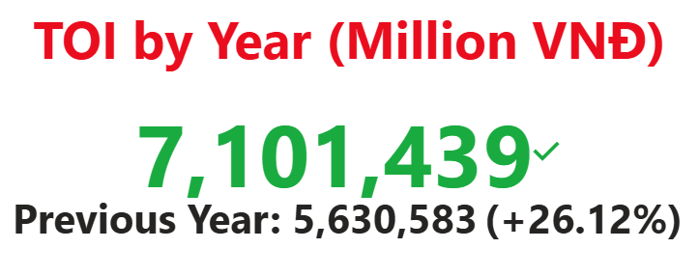
Basic Indicators: TOI Meaning
TOI (or Total Operating Income) is a metric representing the total revenue of the bank including Net Interest Income, Net Fee and Commission Income, Net Other Operating Income, Net Gain/Loss from Forex Trading, Net Gain/Loss from Trading Securities and Net Gain/Loss from Investment Securities.

Slide 4
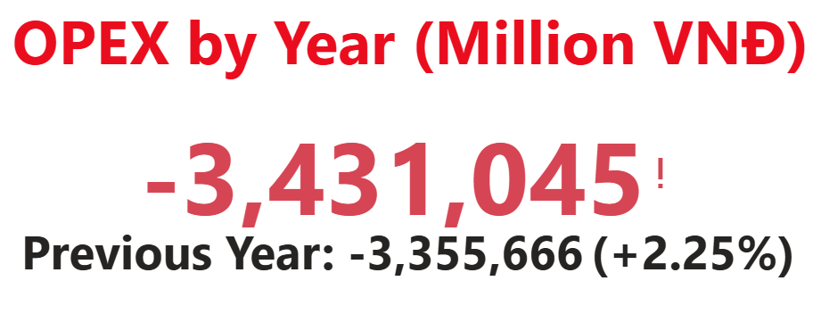
Basic Indicators: OPEX Meaning
OPEX (or Operation Expense) is the cost incurred during regular business activities. In other words, it is the money the banks spends on daily business operations from rent, utilities to salaries of the employees.

Slide 5
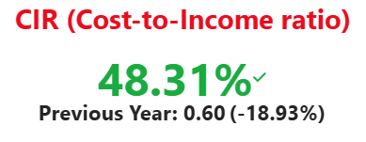
Basic Indicators: CIR Meaning
CIR (Cost-to-Income) measures a bank’s operating expenses against its income. It is ratio calculated by dividing the bank’s OPEX by its TOI

Slide 6
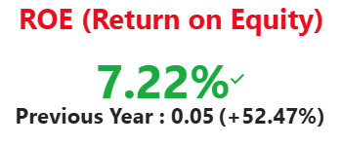
Basic Indicators: ROE Meaning
ROE (Return-on-Equity) is the return on shareholders’s investment. It is calculated through Net Profit after Tax divided by Total Equity. This is how efficient the investment is used.

Slide 7
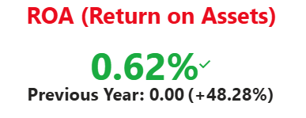
Basic Indicators: ROA Meaning
ROA (Return-on-Assets) is the return on the bank’s total assets. It is calculated through Net Profit after Tax divided by Total Assets instead showing how efficient the assets is in generating profit.

Slide 8
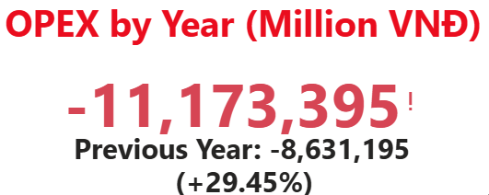
Basic Indicators: The Color Meanings
The colors in these values show different meanings. Green means it performs better than last year and Red means it performs worse instead. For example, OPEX has increased compared to the last year. We do not want the expenses to increase, therefore, the value is red!

Slide 9
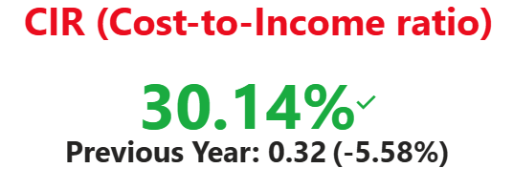
Basic Indicators: The Color Meanings
Or when CIR decreases (the cost is lower than the income generated compared to the last year), it shows green value instead!
==> These indicators are simple enough even for non-finance students or viewers to understand and colourization are based on the logic of better or worse performance!

Slide 10

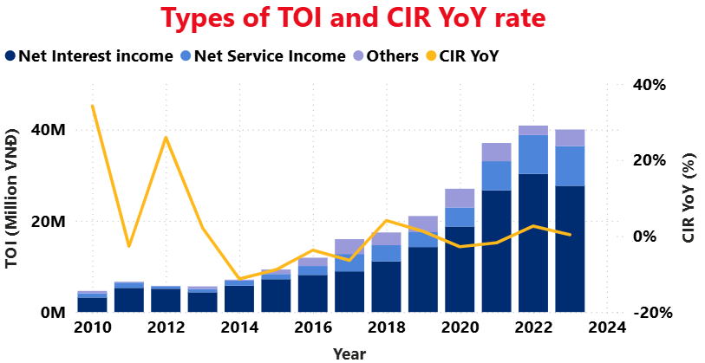

Trend Analysis: TOI and CIR
Comparing TOI and CIR YoY rate, one can see that despite the low TOI in the beginning, the CIR growth rate can decrease significantly in that period. This visualization helps people identify if the TCB’s revenue is growing due to excessive spending or better control at expenses

Slide 11
Trend Analysis: TOI and CIR
Moreover, to see parts of income, the bar shows three types which are Net Interest Income, Net Service Income and Other categories of income as well

Slide 12
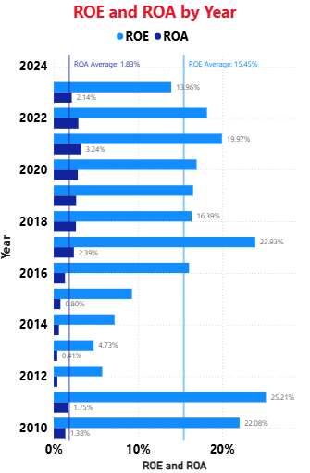
Trend Analysis: ROE and ROA
Another useful trend is to see the comparsion between ROE and ROA overtime since they are quite similar to each other in definition. But in fact, their perfomance are different when the average value for each indicator is added.
==> In short, it is the comparison between Stability and Growth!

Slide 13
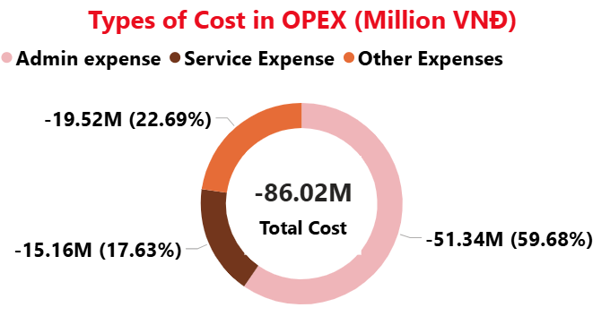
Cash flow Analysis: OPEX Analysis
Since most of the visualization are only about income, now the focus should be on the cost. In finance, cost analysis can be developed into its own domain of study. However, for the purpose of simplification, OPEX is divided into three types: Admin, Service and Other

Slide 14
Cash flow Analysis: OPEX Analysis
Admin expense is the cost covering from salaries, utilities to the bank overhead
Service expense is the cost related to customer service, transaction processing or any fees from third-party services.
Other expenses show that there are other small costs together

Slide 15

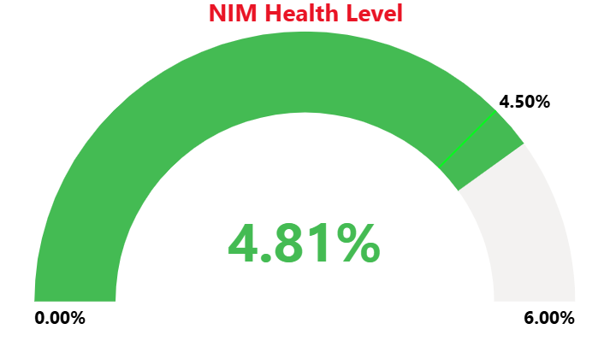
Further Analysis: NIM
NIM (Net Interest Margin) is an indicator that measures the difference between the interest income generated by the bank and the interest expenses ==> A Profitability Metric!

Slide 16
Further Analysis: NIM
It is calculated through Net Interest Income divided by the total of Loans to Customers, Investment Securities and Trading Securities. The gauge also shows different health levels!

Slide 17
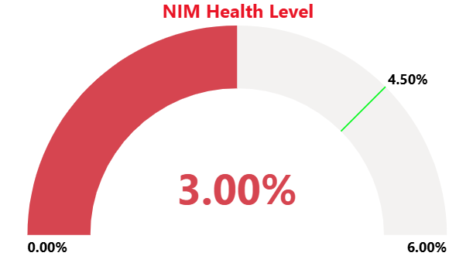
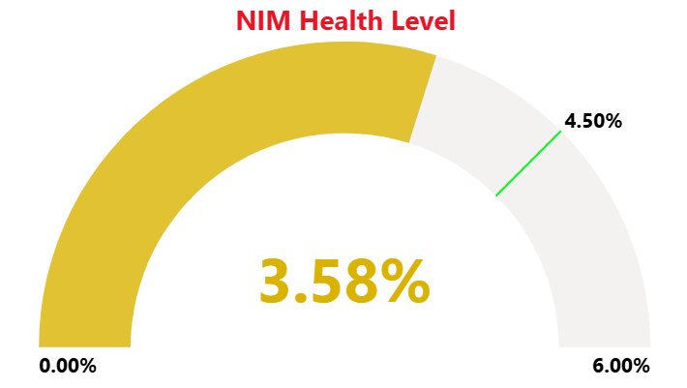
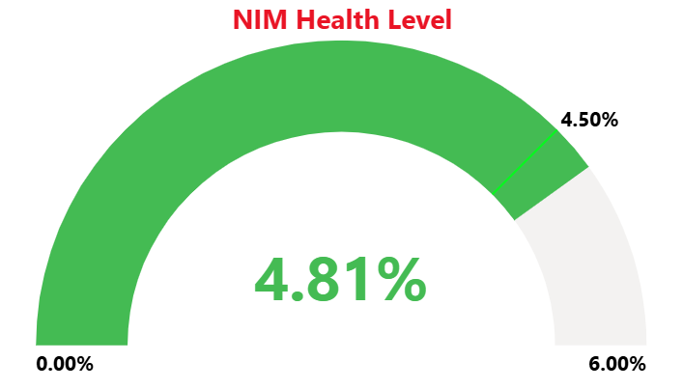
Further Analysis: NIM
A healthy green one would be above 4.5%. Average and below that level is yellow whereas red is very low!

Slide 18
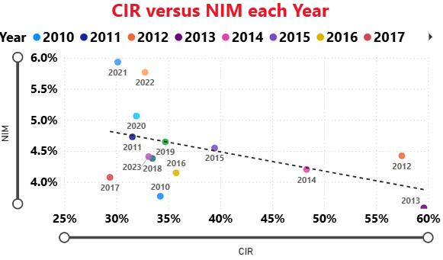
Further Analysis: Correlation
Correlation is the strenth and direction to which the variables are both moving. In other words, it is the relationship they have which is either negative or positive!

Slide 19
Further Analysis: Correlation
Here, the dashboard shows the correlation or relationship between CIR and NIM over the years showing Efficiency versus Profitability!

Slide 20



In conclusion,
The purpose of this dashboard is to show the perfomance of TCB on a financial basic which every viewer can understand. It covers all aspect of a bank (revenue, cost and profit) including a time component which the user can analyze the growth of business
==> Simple but crucial indicators
==> Simple but insightful visualization
==> Includes what matters to the users
==>These are the characteristics to a perfect dashboard!
Point 1
Point 2

Slide 21


Thank You So Much
Any further comments to improve the dashboard is welcomed in arms!

